Slide 1

STATED AND UNSTATED REQUIREMENTS

Slide 2
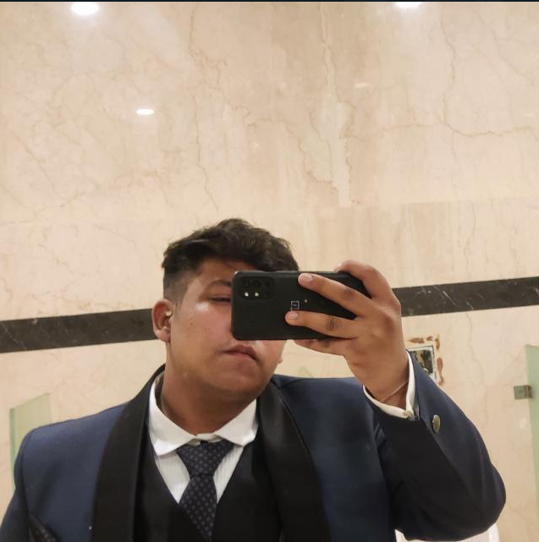
TEAM MEMBERS
JAI khandelwal
Ra2112704010025.
Godfrey ashwanth
RA2112704010020.
Sujal Singh
RA211270401001
PONNURI ANIRUDDHA
RA2112704010015

Slide 3
DISCLAMER
!!! SMOKING IS INJURIOUS TO HEALTH !!!
EVERYTHING IN THIS PRESENTATION IS IMAGINARY
DO NOT TRY TO ATTEMPT THESE STUNTS ANYWHERE
( IN REALITY )

Slide 4
SCENARIO BASED ON BUYING CIGARETTE

Slide 5
DEFINATION
STATED REQUIREMENTS
What the customer asks for. Real. What the stated needs actually mean.
UNSTATED REQUIREMENTS
What the customer also expects but does not ask for. Delight. Needs that are not essential but would delight if met.

Slide 6
Stated Requirement

Slide 7
UnStated Requirement
it gives a nicotine rush.
Reduce stress and anxiety.
Dries your throat.
big filter cigarette are better than small filter cigarette.

